Slide 1
Software Engineering (Project Management) _____________________________________________________
Feb 2013

Slide 2
Project Management
What is Project?
  A project is a finite (having Definitive beginning and end) endeavor undertaken to produce a unique product or service
  A project is a sequence of unique, complex, and connected activities having one goal or purpose and that must be completed by a specific time, within budget, and according to specifications

Slide 3
Project Management…..
What is NOT Project?
  Emergency response to operations problems
    Callouts
    Repairs and troubleshooting
  Routine operations support
    Maintenance of equipments
    Minor modifications

Slide 4
Project Management…..
What is Project Management?
  Project Management is the application of skills, knowledge, tools and techniques to meet the needs and expectations of stakeholders for a project
  Project management is set set of principles and tools for
    Defining / scoping
    Planning
    Executing
    Monitoring & Controlling
The purpose of project management is prediction and prevention, NOT recognition and reaction
Notes:
Proj. Management involves the Planning, Monitoring, and control of people, process and events (risk) that occur during S/W development (right from preliminary concept to deployment)

Slide 5

Project Management Triangle
Time
Quality
Cost
Scope

Slide 6
Key Areas of Project Management
Scope management
  Definition and control of what IS and IS NOT included in the project
Issue Management
  Issues are restraints to accomplishing the deliverables
  Identified throughout the project and logged and tracked through resolution
Cost Management
  To ensure the project is completed within the approved budget

Slide 7
Key Areas of Project Management…..
Quality Management
Communications Management
  To ensure timely and appropriate generation, collection, dissemination, and storage of project information
Risk Management
Change Control Management
  Define how changes to the project scope will be executed

Slide 8
Project Management…..
Manage 4 Ps
  People
    S/W development is intensely human endeavor
  Product
  Process
    Ignoring process runs the risk of competent technical tools & techniques going into vein
  Project
Notes:
Manage 4 Ps. Order is not arbitrary
S/W development is intensely human endeavor.
Ignoring process runs the risk of competent technical tools & techniques going into vein

Slide 9
People
Stakeholders (Sr. Managers, PM, Team members, BOs, BUs)
Team Leaders
  Motivate, Organize, Innovate (MOI)
  Problem solving
Team Members
  Team building, Conflict resolution
Paradigm for setting up teams
  Closed: Traditional, Hierarchy based, structured
  Random: Individual players, requires innovation
  Open: Structured as well as innovative
  Synchronous: natural compartmentalization
Notes:
MOI (Motivation, Organization Innovation)
Motivation – Ability to encourage people
Organization – Ability to invent new process (or alter existing one) which will enable preliminary concept to be translated into operational product
Innovation – Ability to encourage people to create & feel creative even when they have to work within the boundaries
Problem solving – Ability to diagnose the issue (technical or organizational) and provide solution or motivate people to develop solution. Apply lessons learnt from past project.
Paradigm for setting up teams
Closed – work well when work similar to past but may not when more innovative work
Random – Loosely structure. Good when innovation or technical break thru is needed
Open – Structures a team in a manner of “Closed” control at some extent but also much of the innovation happens when using Random structure. Heavy communication & consensus based decision making are main characteristics.

Slide 10
Product & Process
Scope
  Establish objective & Scope of the project
  Defines the final deliverable and outcome
  States in clear terms what is to be accomplished
  Is a reference point for questions about scope and purpose of the project
Notes:
Objective & Scope should be established. Identify Technical & management constraint. (Without which reasonably accurate estimate of cost, Effective risk assessment, and manageable project schedule would be difficult).

Slide 11
Product & Process…..
Problem decomposition
Process decomposition
Identify Technical & management constraint
  It helps in
    Estimating the cost
    Effective risk assessment / management
    Managing the project schedule
Notes:
Objective & Scope should be established. Identify Technical & management constraint. (Without which reasonably accurate estimate of cost, Effective risk assessment, and manageable project schedule would be difficult).

Slide 12
Project
5 part common sense approach for PM
  Start on the right foot
  Maintain momentum
  Track progress
  Make smart decisions
  Conduct a postmortem analysis
5W-HH principal
  Why is the system being developed?
  What will be done?
  When will it be done?
  Who is responsible for a function?
  Where are they organizationally located?
  How will the job be done?
  How much of each resource is needed?

Slide 13
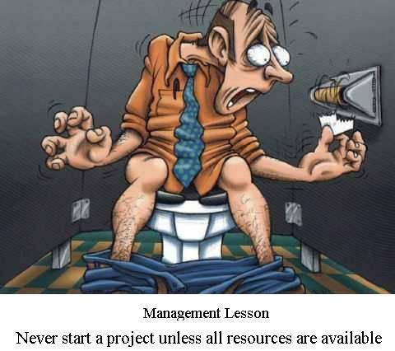
Project (Lets have a Fun)
Do Not Start a Project Unless All Resources Are Available

Slide 14




Project Lifecycle
Support Processes
RFP
Estimation
Risk identification
Technical Chapter
Selection of Software Life Cycle
Mapping of phases and deliverables
Initiation
Planning
Rework
Monitoring
Closure
Reviews (Senior / Peer / QA)
Yes
Findings
Estimation
Risk Mgmt
Defect Prev
Config Mgmt
No
Final proposal by marketing to Client
Findings

Slide 15

Project Initiation
Contract
Contract / PO
Contract Review
Re-estimation, if required.
Risk identification
Resource Plan
Contract Review
Re-estimation, if reqd.
Risk identification
PCD preparation
High level trg and resource plan
Rework
Sr. Mgmt Review
Reviews (DH / QA)
Rework if reqd
Yes
Findings
No
PCD Approved by CC Chief / BDO
Project Start

Slide 16
Project Planning
Project Initiated
Decide Processes
Arrive at schedule
Prepare detailed plans
Decide standards
Sr. Mgmt Review
Rework if reqd
Project kick-off

Slide 17
Project Monitoring
Project Started
Weekly Meetings
Measures, Metrics
Audits
Reviews
Testing
Variations / Deviations
Sr. Mgmt Review
Project Closure

Slide 18
Project Closure
Project Completed
Closure Meeting
Learning, DOs & DON’Ts
Best Practices

Slide 19
Why it fails?
10 signs that indicates project is in danger
  …..John Reel
  S/W professionals Don’t understand business needs
  Poorly defined project scope
  Poor change control management
  Technology changes
  Change in business needs (or ill-defined)
  Unrealistic deadlines
  Users are resistant
  Sponsorship is lost (or never properly obtained)
  Lack of appropriate skills
  Best practices & Lessons learnt are ignored

Slide 20
Q & A
Any Question?

